Slide 1


QUANTAM
COMPUTING
MSC.(CS) – I 2021-22
CREATED BY :
AKASH JONGHALE &
PRATHAMESH SHETE

Slide 2
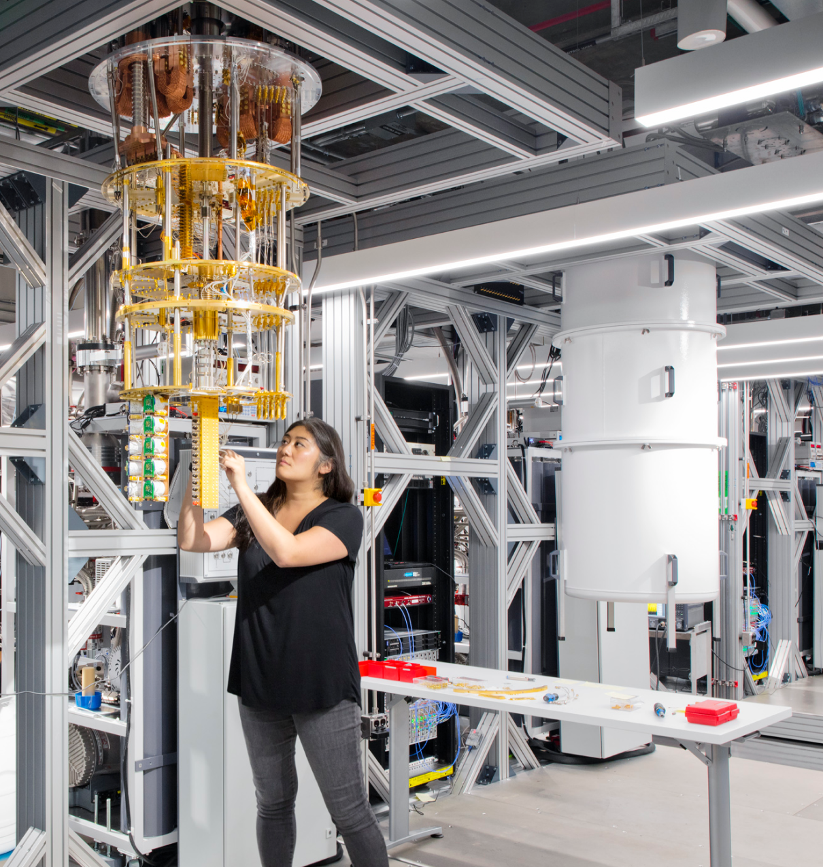
Introduction
Quantum computing is a modern way of computing that is based on the science of quantum mechanics and its unbelievable phenomena. It is a beautiful combination of physics, mathematics, computer science and information theory..

Slide 3
What Is Quantam Computing
While everyday analog computing is limited to having a single value of either 0 or 1 for each bit, quantum computing uses quantum bits (qubits) that are simultaneously in both states (0 and 1) at the same time.
The consequence of this superposition, as it’s called, is that quantum computers are able to test every solution of a problem at once. Further, because of this exponential relationship, such computers should be able to double their quantum computing power with each additional qubit.

Slide 4
Basic Concept Of Quantum Computer & Existing Computer
Quantum computer
A Quantum Computer, on the other hand, “Quantum Bit” or “Qubit” instead of bit.
A qubit also makes use of two states (0 and 1) to hold information but in contrast to a bit, In this state, a qubit can take on the properties of 0 and 1 simultaneously at any one moment.
According, two qubits in this state can express the four values of 00, 01, 10, and 11 all at one time.
Existing Computer
In existing computers, all information is expreesed in terms of 0s and 1s and the entity that carries such information is called a “bit”.
A bit can be in either a 0 or 1 state at any one moment in time.

Slide 5
Advantages
Ability to solve scientific and commercial data.
Process data in a much faster speed.
Capability to convey more accurate answers.
More can be computed in less time.
These are used to protect secure Web pages, encrypted email and many other types of data.

Slide 6
Disadvantages
Lots of heat.
Expensive
Difficult to build
Not suitable to word processing and email.
Problem of it need of a noice free & cool environment.
Complex hardware schemes like superconductors.

Slide 7
Applications
Encryption Technology.
Ultra-secure and Super-dense communications.
Improved error correction and error detection.
Molecular simulation.
Cryptography.
Searching.
Factorizations.
Encryption problem & Quantum chemistry problem.

Slide 8
THANKS!

